Slide 1

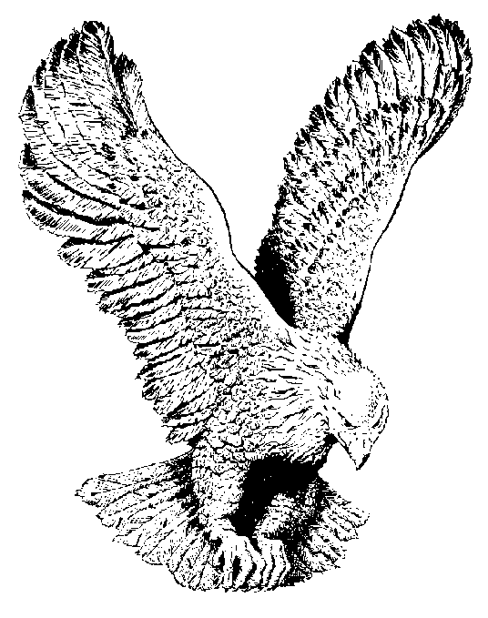
HE OWNS THE CATTLE
He owns the cattle on a thousand hills,
The wealth in every mine;
He owns the rivers and the rooks and rills.
The sun and stars that shine;
Wonderful riches more than tongue can tell,
He is my Father, so they’re mine as well;
He owns the cattle on a thousand hills
And so I know He cares for me.

